Slide 1
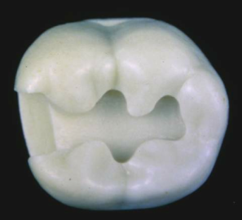
Class II cavity modifications

Slide 2
Contents
- Introduction
- Classification
- Principles of cavity preparation
- Class II cavity preparation
- Need for class II cavity modifications
MODIFICATIONS
- Class II Design I
- Design 2
Design 4
Design 5

Slide 3
- Design 3
- Design 4
- Design 5
- Design 6
- Design 7
- Design 8
- Conclusion

Slide 4
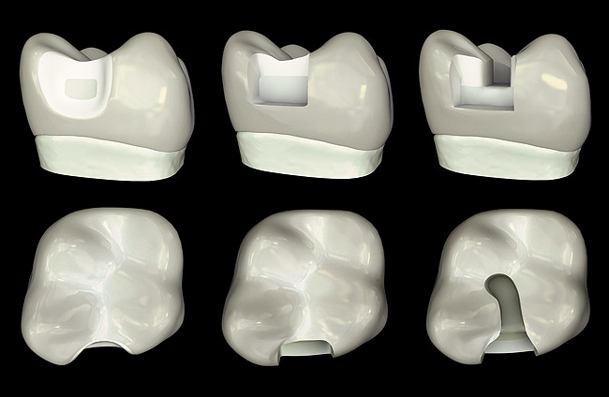
INTRODUCTION

Slide 5
CLASSIFICATION

Slide 6
PRINCIPLES OF CAVITY PREPARATION
Stage I
- Outline form
- Primary Resistance form
- Primary Retention form
- Convenience form

Slide 7
Stage 2
- Removal of remaining carious dentin
- Pulp protection
- Secondary resistance and retention form
- Finishing of enamel walls and margins
- Cleaning,inspecting and sealing

Slide 8
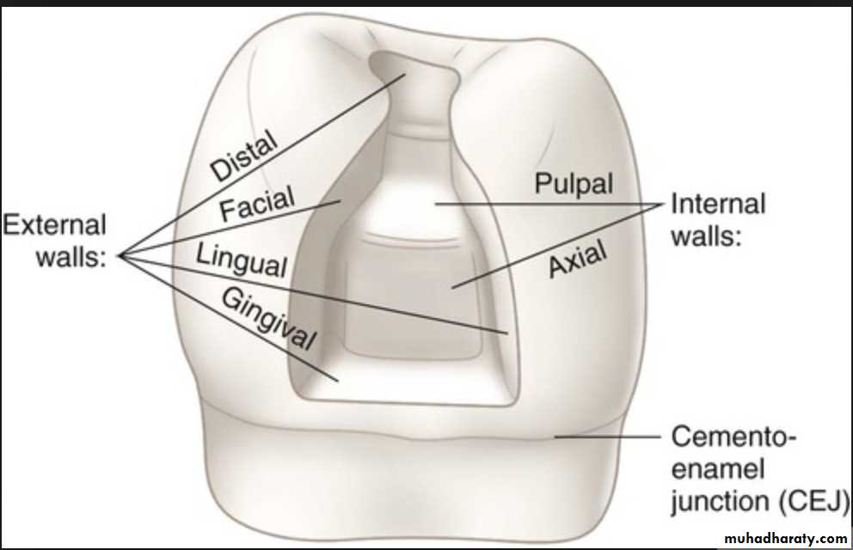
CLASS II CAVITY PREPARATION

Slide 9
Need for Class II cavity modifications
Amount of Tooth structure
Prognosis
Stress distribution

Slide 10
Class II Design I
Conventional design

Slide 11
Internal Anatomy

Slide 12
INDICATIONS
Large proximal lesions
Stress concentration areas
High caries & plaque indices

Slide 13
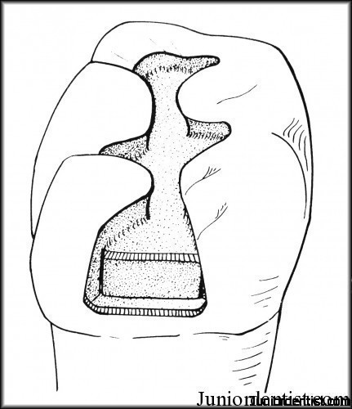
Class II Design 2
Modern design

Slide 14
Internal Anatomy

Slide 15
INDICATIONS
Moderate to small lesions
Occlusal lesions involving one or both marginal ridges
Sufficient bulk in buccal & lingual walls

Slide 16
Class II Design 3
Coservative design

Slide 17
Internal Anatomy

Slide 18
INDICATIONS
Decay restricted to proximal surface
High masticatory loading
Good oral hygiene

Slide 19
Class II Design 4
Simple design

Slide 21
Internal Anatomy

Slide 22
INDICATIONS
Diastema or adjacent tooth is missing
Rotated or inclined
Proximal lesions tapered with wide gingival embrasure

Slide 23
Class II Design 5

Slide 24
Internal Anatomy

Slide 25
INDICATIONS
Intact marginal ridge
Normal displacing forces
Gingival embrasure is not accessible

Slide 26
Class II Design 6

Slide 27
Internal Anatomy

Slide 28
INDICATIONS
Cusp length is more or double its width
Cusp is completely missing
Teeth with doubtful prognosis

Slide 29
Class II Design 7
Combination of class II with class v

Slide 30
Internal Anatomy

Slide 31
INDICATIONS
Surface defects or decalcifications
Class v lesion involving adjacent axial angles
Lesion apical to contact area

Slide 32
Class II Design 8

Slide 33
Internal Anatomy

Slide 34
INDICATIONS
Sufficient pulp chamber
Adequate remaining tooth structure
Tooth contains sufficiently large root canals

Slide 35
CONCLUSION
While restoring class II lesions we must strive towards achieving proper form of the restoration. So that it can fulfill its function of providing longevity and stability to the natural dentition without encroaching physiological limits of pulp, periodontium and occlusion.

